Slide 1
SQL for Data Querying and Analysis
Week 2

Slide 2
Agenda
Review
Joins (Inner, Left/Right, Outer)
Sets (Union, Intercept, Except)

Slide 3
Review

Slide 4
Anatomy of a SQL Query
SELECT
COLUMN_1, SUM(COLUMN_2)
FROM
TABLE_NAME
WHERE
COLUMN_1 = ‘VALUE’
GROUP BY
COLUMN_1
HAVING
SUM(COLUMN_2) > 10
ORDER BY
COLUMN_1;
Select Clause
From Clause
Where Clause
Group By Clause
Having Clause
Order By Clause
Notes:
6 clauses, not every query will have all 6
Only SELECT and FROM are required
Order of clauses matters! – Can order by go before having?
Note the indentation – good syntax! (as queries get larger this becomes super important)

Slide 5
Review
XXX

Slide 6
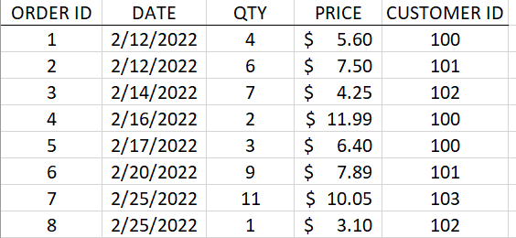
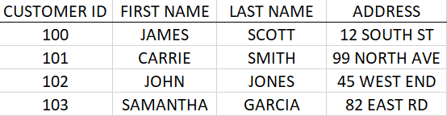
What are Relational Databases?
Relational databases store data in tables that are related to one another
They are key to understanding and writing effective SQL code!
Every row in every table has a unique key that identifies the row and can help relate the table to other tables in the database
Why not store data in a spreadsheet??
ORDERS TABLE
CUSTOMERS TABLE

Slide 7
Relational Database Concepts
Primary versus foreign keys here

Slide 8
Joins

Slide 9
What is a Join?
A join is an operation that uses related columns between tables to combine data from multiple tables into one query
Joins typically leverage both a primary key and a foreign key
Joins are located in the from clause of a SQL query *
* There is an additional syntax for joins from version SQL92 that puts joins in the where clause, but this syntax is considered less flexible and les interpretable

Slide 10
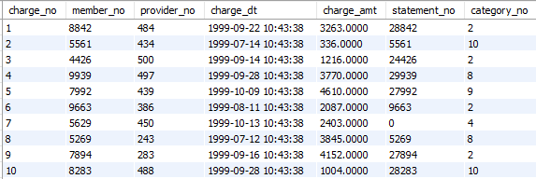
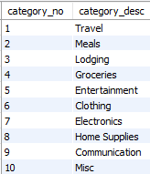
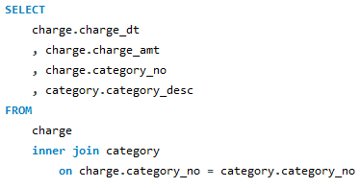
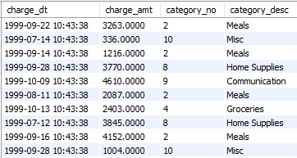
Join Example
Charge Table
Category Table
Query
Result

Slide 11
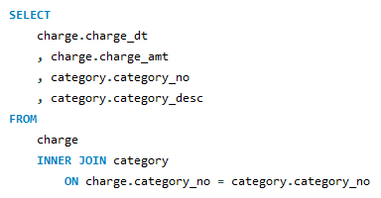
Anatomy of a Join
When joining multiple tables, columns in the select clause should include the source table as a prefix to specify to the server where to pull the column from and avoid ambiguity
Specify what kind of join you are performing (INNER) and what table you are joining in (category)
The ON subclause shows how tables are related by specifying their relationship between 1 or more keys

Slide 12
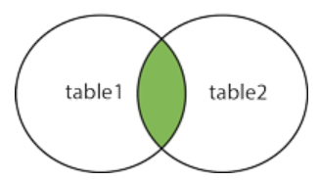
Inner Joins
An inner join return all records that have matching values in both tables
Inner joins can be useful for filtering to a subset of your data

Slide 13
Demo Set 2.1

Slide 14
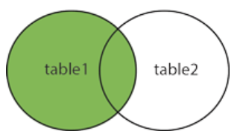
Left Join
A left join returns all rows from the left table specified in the join and only the matched records from the right table
Left table is responsible for determining number of rows in result set
Left joins are useful when you want to bring in data from other tables without sacrificing any rows (so very useful!)
Notes:
191 example for demoo?

Slide 15
Demo Set 2.2

Slide 16
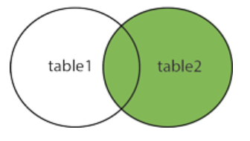
Right Join
A right join returns all rows from the right table specified in the join and only the matched records from the left table
Right table is responsible for determining number of rows in result set
While right joins function quite similarly to left joins, they are rarely used and are not supported by all database servers!
Notes:
191 example for demoo?

Slide 17
Demo Set 2.3

Slide 18
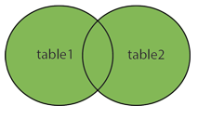
Full Joins
A right join returns all rows from the right table specified in the join and only the matched records from the left table
Right table is responsible for determining number of rows in result set
While right joins function quite similarly to left joins, they are rarely used and are not supported by all database servers!

Slide 19
Demo Set 2.4

Slide 20
Using Table Aliases with Joins
XXX

Slide 21
Pop Quiz!

Slide 22
Which query runs successfully?
A)
B)
SELECT
charge_no
, charge_amt
, statement_no
, statement_dt
FROM
charge
INNER JOIN statement
ON charge.statement_no = statement.statement_no;
SELECT
charge.charge_no
, charge.charge_amt
, charge.statement_no
, statement.statement_dt
FROM
charge
INNER JOIN statement
AS charge.statement_no = statement.statement_no;
C)
D)
SELECT
charge.charge_no
, charge.charge_amt
, charge.statement_no
, statement.statement_dt
FROM
charge
INNER JOIN ON statement
charge.statement_no = statement.statement_no;
SELECT
charge.charge_no
, charge.charge_amt
, charge.statement_no
, statement.statement_dt
FROM
charge
INNER JOIN statement
ON charge.statement_no = statement.statement_no;
Notes:
A is wrong because no table references
B is wrong because you have AS instead of ON
C is wrong because ON becomes right after INNER JOIN

Slide 23
Which query runs successfully?
A)
B)
SELECT
charge_no
, charge_amt
, statement_no
, statement_dt
FROM
charge
INNER JOIN statement
ON charge.statement_no = statement.statement_no;
SELECT
charge.charge_no
, charge.charge_amt
, charge.statement_no
, statement.statement_dt
FROM
charge
INNER JOIN statement
AS charge.statement_no = statement.statement_no;
C)
D)
SELECT
charge.charge_no
, charge.charge_amt
, charge.statement_no
, statement.statement_dt
FROM
charge
INNER JOIN ON statement
charge.statement_no = statement.statement_no;
SELECT
charge.charge_no
, charge.charge_amt
, charge.statement_no
, statement.statement_dt
FROM
charge
INNER JOIN statement
ON charge.statement_no = statement.statement_no;
Notes:
A is wrong because no table references
B is wrong because you have AS instead of ON
C is wrong because ON becomes right after INNER JOIN

Slide 24
Cross joins
Put here??

Slide 25
Joining More than 2 Tables
SQL queries can include as many joins as needed to produce your desired result set
For every join in your query the table, join type and on subclause must be specified
Join order does not matter!
Regardless of order in your query the database server will select the optimal table to begin with and from there decide which joins to perform

Slide 26
Demo Set 2.5

Slide 27
Sets

Slide 28
Sets
In addition to joins, sets (meaning sets of rows) and set operators are a great way to combine, filter, and manipulate your data across multiple sources
In order to leverage set operators each set must have the same number of columns and the same types for corresponding columns
Set operators: UNION, INTERSECT, and EXCEPT

Slide 29
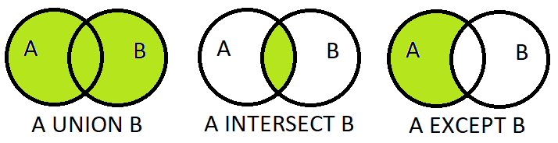
Set Operators
UNION keeps all rows from both sets and removes duplicates. UNION ALL keeps all rows from both sets without removing duplicates
INTERSECT keeps all rows that are present in both sets
EXCEPT keeps all rows that are present in the first set but are not present in the second set

Slide 30
Demo Set 2.7

Slide 31
Pop Quiz!

Slide 32
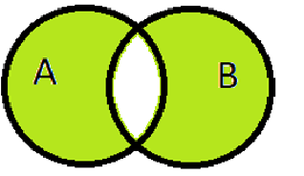
Using set operators, how would you filter to the green set of data:
A)
B)
(A UNION B) EXCEPT (A INTERECT B)
(A INTERSECT B) UNION (B INTERSECT A)
C)
(A EXCEPT B) UNION (B EXCEPT A)
D)
(A UNION B) EXCEPT (B EXCEPT A)

Slide 33
Using set operators, how would you filter to the green set of data:
A)
B)
(A UNION B) EXCEPT (A INTERECT B)
(A INTERSECT B) UNION (B INTERSECT A)
C)
(A EXCEPT B) UNION (B EXCEPT A)
D)
(A UNION B) EXCEPT (B EXCEPT A)

Slide 34
Review!
XXX

Slide 35
Resources to Practice
Code Academy SQL Course: https://www.codecademy.com/learn/learn-sql
SQL Zoo: https://sqlzoo.net/
W3 Schools: https://www.w3schools.com/sql/sql_exercises.asp

Slide 36
Thank You!

Slide 37
Appendix

Slide 38
Appendix
XXX

